Slide 1
Public Procurement Authority Department of International Relations
Measuring Performance of Public Procurement
in Turkey

Slide 2
Agenda
Introduction
Public Procurement System in Turkey
Measuring Performance in Turkish Public Procurement System
Challenges
E-Procurement and Business Intelligence
Q & A
Measuring Performance (cont.)

Slide 3
Introduction
Public Procurement accounts for a significant share of gross domestic product of countries (EU average is %19 of the GDP).
Therefore, effective, transparent and competitive public procurement system is of paramount importance in terms of effective use of public resources.
Performance of public procurement should be measured to see whether the procurement system works efficiently in accordance with the objectives set.

Slide 4
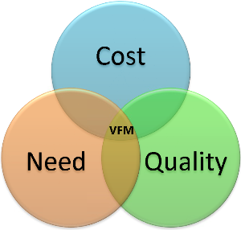
Introduction
Value for money (VFM) is defined by business dictionary;‘A utility derived from every purchase or every sum of money spent.’
On the other hand, value for money is based not only on the minimum purchase price (economy) but also on the maximum efficiency and effectiveness of the purchase.
So that VFM is crucial for the measurement of performance of public procurement.

Slide 5
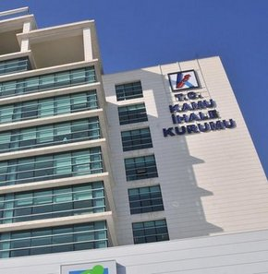
Turkish Public Procurement System (TPPS)
Turkish Public Procurement Sytem has four historical cornerstones:
1) Auction, Contest and Tender Law no 661 dated 22 April 1925
2) Auction and Tender Act no 2490 dated 10 December 1934
3) State Tender Law no 2886 dated 08 September 1983
4) Public Procurement Law (PPL) no 4734 dated 04 January 2002
PPL has created an advanced model of international procurement regulations.
Notes:
Turkish Public Procurement Sytem has four historical background dates.
The first Public Procurement Law in the Republic of Turkey is Auction, Contest and Tender Law no 661 dated 22 April 1925.
This Law was repealed by Auction and Tender Act no 2490 dated 10 December 1934.
Public procurement has been continuously reformed to ensure effective and efficient use of public resources and to modernize the PP process.
On 08 September 1983, new law on public procurement, namely State Tender Law no 2886 was adopted by the Parliament.
Finally, on 04 January 2002, Public Procurement Law (PPL) no 4734 was enacted.

Slide 6
Turkish Public Procurement System (TPPS)
Currently, Public procurement is regulated by Public Procurement Law No. 4734 which entered into force on January 1, 2003.
One of the objectives of preparing a new law on public procurement was adaptation to international instruments on public procurement (EU Procurement Directives, UNCITRAL Model Law on Procurement, World Bank Procurement Guidelines, etc.).
Public Procurement Law
no. 4734
Notes:
Currently, public procurement is regulated by Public Procurement Law No. 4734 which entered into force on January 1, 2003.
One of the objectives of preparing a new law on public procurement was adaptation to international instruments on public procurement (EU Procurement Directives, UNCITRAL Model Law on Procurement, World Bank Procurement Guidelines, etc.). The enactment of a new public procurement law compatible with international instruments was an important public reform.

Slide 7
Methodology of Measuring Performance
National Level (Meta Level)
Macro Level
Micro Level
Overall Evaluation in Three Parameters
Notes:
Performance of public procurement was measured at three levels using several parameters.

Slide 8
Measuring Performance
Number of Advices Provided by the PPA
Regulation Department attended 63 meetings in order to guide the implementation of public procurement legislation in 2013.
Average time period for resolving disputes after submission of complaints
Notes:
At national (meta) level, assesment of performance was based on regulation, guidance and dispure resolution.

Slide 9
Measuring Performance
Macro Level
Notes:
At macro level, performance was measured based on contracting authorities’ activities, taking into account PPA’s activities.

Slide 10
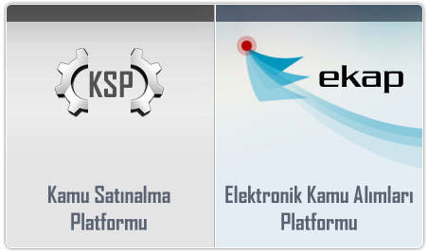
E-Procurement
Electronic Public Procurement Platform (EPPP) became operational on 1 September 2010.
All transactions relating to public procurement are carried out through or registered on EPPP.
Operations that can be performed in EPPP include publication of contract notices, preparation of contract document, downloading the contract document, verification of tax liability, balance sheet and income statement information, social security premium debt information of the economic operators.

Slide 11
Measuring Performance
Savings achieved by using Electronic Public Procurement Platform:
Contracting Authorities
Savings due to less printing of tender documents (350.000 tender documents, avg. 50 pages, cost per page0,2 TL) | 3,5 million TL (1,15 million €)
Time savings (11 person/day, daily cost 50TL, 150.000 tenders annually) | 82,5 million TL (27 million €)
Contract Value Savings (Contract Value/Estimated Cost Ratio decreased from 81% to 74%, average number of tenders increased from 3,3 to 5,6 in 2011 and from 2,6 to 5,1 in 2012 ) | Approximately 1,5 billion TL annually
TOTAL REALIZED SAVINGS (yearly) | 1,6 billion TL (520 million €)
Notes:
The amount of savings is calculated on annual basis.

Slide 12
Measuring Performance
Savings achieved by using Electronic Public Procurement Platform:
Economic Operators
Savings due to tender document acquisition (yearly) (350.000 tender documents* document price) | 54 million TL (18 million €)
Transportation savings (yearly) (350.000 tender documents* 10 TL/tender document) | 3,5 million TL (1,15 million €)
Time Savings (yearly) (350.000 tender documents* 1 man/day*35 TL daily) | 12,2 million TL (4 million €)
TOTAL REALIZED SAVINGS (yearly) | 69,7 million TL (22,6 million €)
Notes:
The amount of savings is calculated on annual basis.

Slide 13
Business Intelligence
A business intelligence application was put into use
on Electronic Public Procurement Platform in order to:
gather statistical data about public procurement
for business processes analysis,
standardize analysis of public procurement data
and development of public procurement reports,
faster retrieve up to date and instant data,
more effectively provide procurement data to the other units of PPA,
provide statistical information within the scope of «The Law of Info Access Rights No. 4982»,
provide information to contracting entities, economic operators and public in a visually rich and dynamic way,
improve public procurement processes by employing data mining.

Slide 14
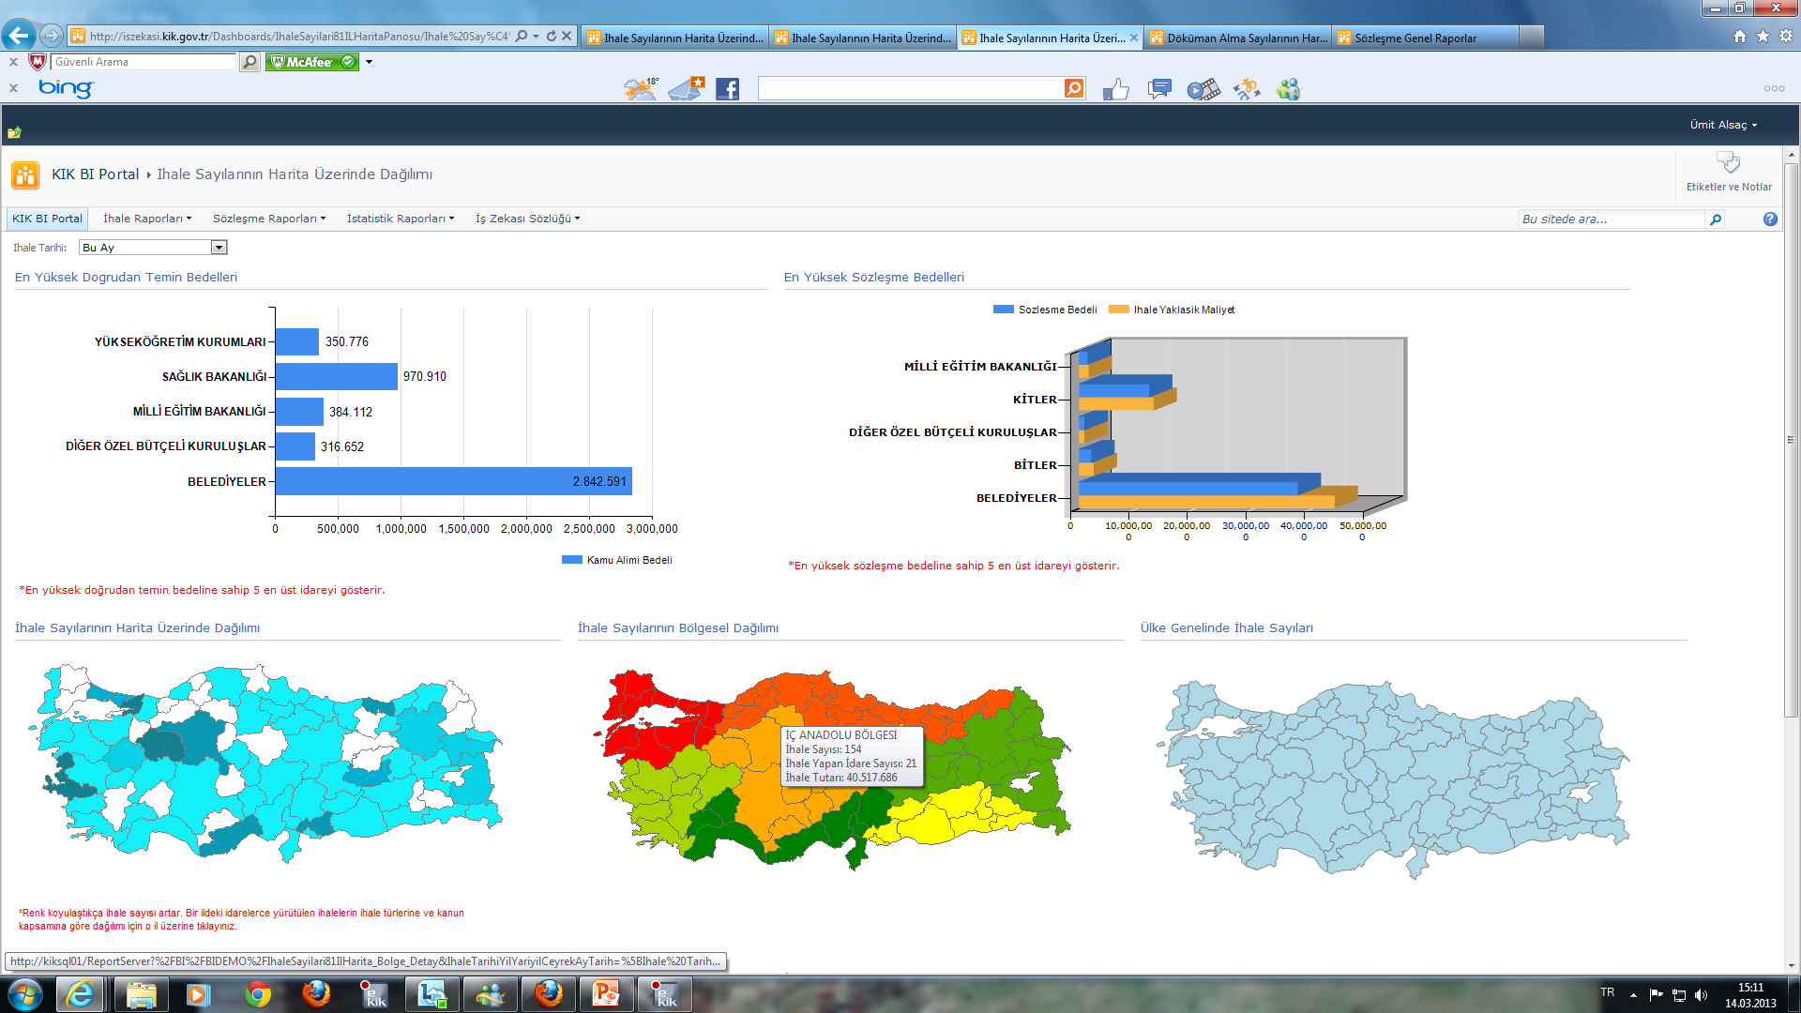
Business Intelligence
Notes:
Business intelligence helped to receive quicker responses on statistical information regarding public procurement .

Slide 15
Measuring Performance
Use of Competitive Procedures
Competitive procedures should be used as much as possible for competition and transparency.
In 2013, 93,28% of all public contracts subject to the PPL are awarded using competitive procedures.

Slide 16
Measuring Performance
Savings
Average percentage of savings should be as high as possible to achieve best value for money.
In 2013, estimated cost / contract value ratio was 76%.
The graph shows that through using competitive procedures how much saving was achieved based on estimated cost / contract value comparison.

Slide 17
Measuring Performance
Use of EPPP by Economic Operators to Obtain Tender Document
Use of electronic tools must be encouraged for the efficiency of the procurement system.
The graph shows that the use of EPPP is very common among economic operators.

Slide 18
Measuring Performance
Average Participation Rate
Average participation rate to public procurement should be high as much as possible to ensure competition.
In 2013 average number of tenders per public contract was 4,21.

Slide 19
Measuring Performance
Number of Complaints to the PPA
An efficient review and remedies system should be established to ensure compliance by the contracting authorities.
In 2013, 95,64% of public contracts were awarded without any dispute.
Total number of complaints was 5.093, which constitutes 4,36% of all contracts that can be appealed in 2013.

Slide 20
Measuring Performance
Decisions of the PPA
The graph shows the decisions of the PPA upon complaints.
The PPA reviews and concludes the complaints within 20 days after all the necessary documents are received.
In 2012 and 2013, more than half of the complaints were rejected.

Slide 21
Measuring Performance
Performance of Review by the PPA
The graph shows the number of decisions of the PPA challenged before the courts and the results of the legal proceedings.
In 2013, 84,66% of decisions of the PPA was not challenged before the courts which shows that a large majority of stakeholders are satisfied with the review by the PPA.

Slide 22
Measuring Performance
Micro Level
Procurement of Works | Former Legislation | New Legislation
Average completion period of projects | L | H
Completion of projects without cost overrun | H | L
Participation to procurement | L | H
Former legislation denotes State Procurement Law no. 2886 and new legilation denotes Public Procurement Law no. 4734 which is mostly in line with international regulations.
Notes:
At micro level, comparison is made with regard to completion of projects in planned time and budget and the number of tenderers.

Slide 23
Overall
 | Micro Level | Macro Level | Meta Level
Efficiency | High | Neutral | High
Transparency | High | High | High
Equal Treatment | High | High | High
Notes:
As a result, considering efficiency, projects(each tender) can be conducted efficiently compare with former projects and getting increase day by day. This result which is obtained from projects indicates the efficiency of CAs and PPA work efficiently, thus in the national level the efficient works such as a better regulation, a better guidance can be seen easily.
With the PPL N. 4734, Transparency is accepted as one of the main principle of Turkish Procurement Law, so this principle affects whole market in the three level. So, Both project basis and organizational level or national level, transparency is provided through EPPP.
Also in terms of “equal treatment” we can claim that each contracting authority, PPA as well, are conducting their tender transactions by taking into account “equal treatment” principle, the number of awarded foreign bidders is also evidence for this result.

Slide 24
Challenges
New Developments
Amendments to legislation, EU Directives, GPA, etc.
Capacity
Administrative capacity in contracting authorities and economic operators
Sustainability
• Sustainability of procurement performance
Notes:
Sustainability is a challenge because in both CAs and economic operators, personnel who deal with procurement easily move another sector. Keeping personnel is very hard to maintain at least in the same level

Slide 25
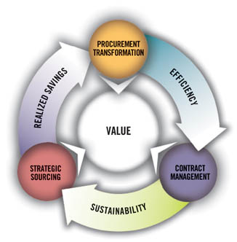
How to Deal With Challenges
Innovative Procurement
Green Procurement
Social Concerns
More Integration to International Regulations
Notes:
You don't know what you don't know
You can't do what you don't know
You don't know until you measure
You don't measure what you don't value
You don't value what you don't measure
These points will bring a better measure, a better measure will direct our future…

Slide 26
THANK YOU
Q & A

